Slide 1
Group - 5 CAPSTONE PROJECT
Finance and Risk Analytics
Project Title: Predicting default loan applicants using past behaviour
Presented By:
Alwyn Sebastian
Bhavana Ramachandra
Atul Kumar
Ajay Banerjee
Rahul Mathew
Project Mentor:
Chandrakani Siva Prasad

Slide 2
Contents
Problem Statement
Univariate and Bivariate Analysis
Correlation Matrix
Data Preprocessing
Model Performances
Conclusion

Slide 3
Problem Statement
Identifying defaulters for loan to minimize losses for the Lending Club.
Identifying key factors influencing loan defaults.
Providing actionable insights to improve lending strategies.
The dataset obtained from Lending Club official website contains 2260668 rows and 145 columns.

Slide 4
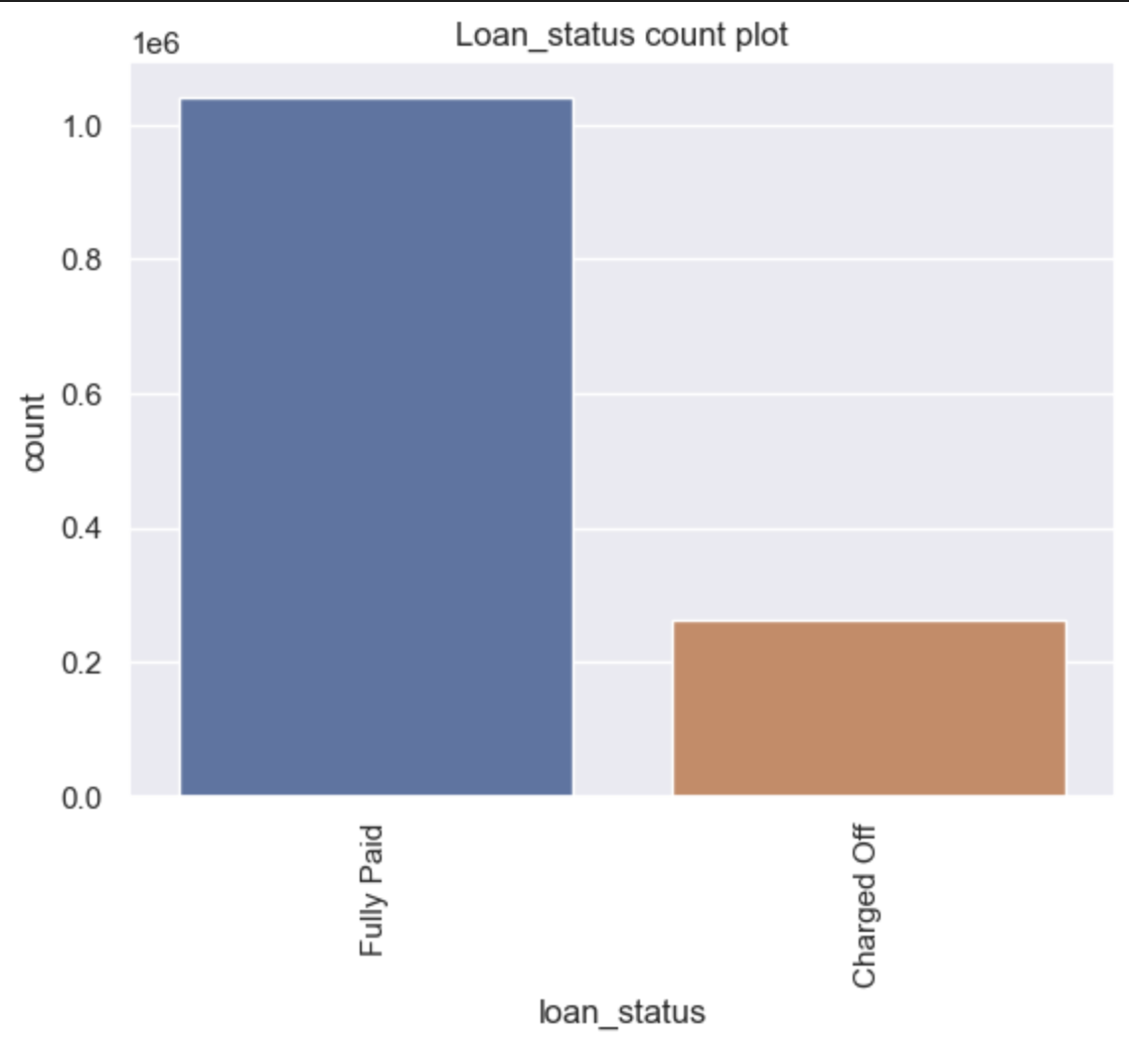
Univariate and Bivariate Analysis
The target variable chosen here is
Loan_status.
We consider two categories for our analysis,
Fully Paid and Charged Off.
We observe that our target variable is
imbalanced.

Slide 5
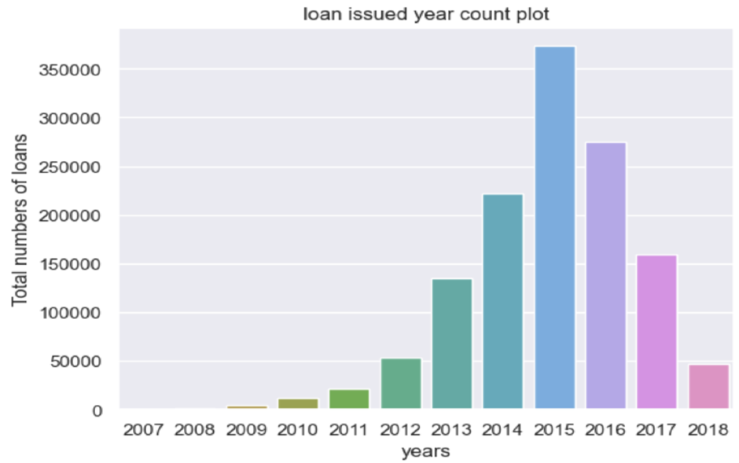
Univariate and Bivariate Analysis
Here we look at the year of loan approved or issued
2015 had the most number of approved loans
The approval rates for loan is increasing from 2009 to 2015
We can see the dip in 2015 to 2018

Slide 6
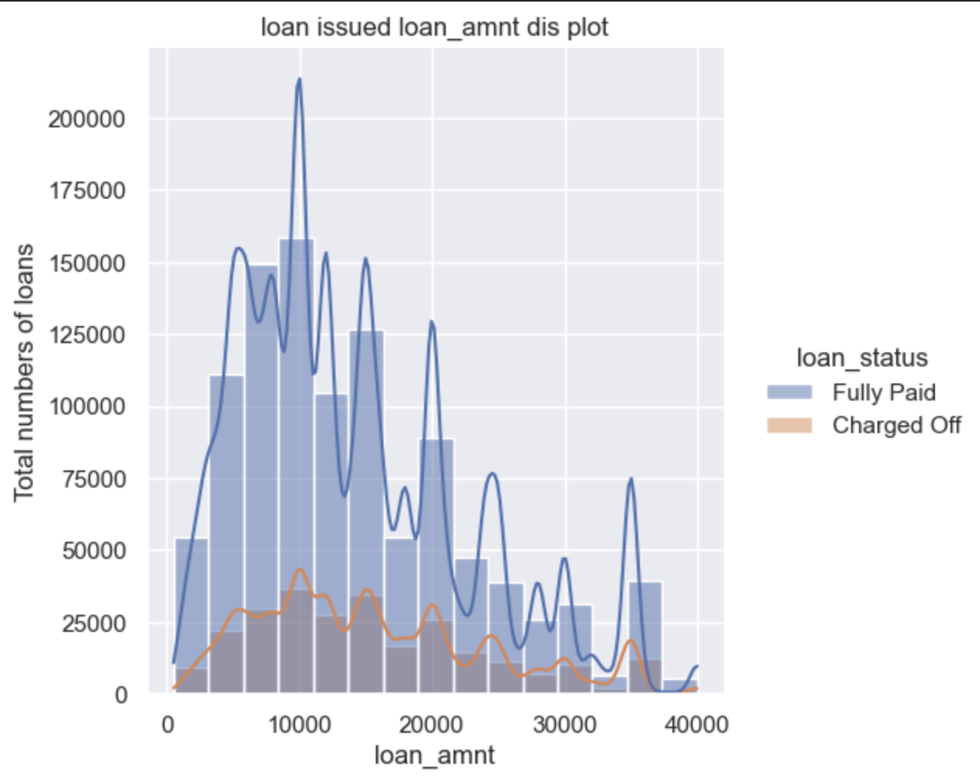
Univariate and Bivariate Analysis
Here we look at how total number of loans vary according to loan amounts.
We observe that most loans are given for the amount between 10000 and 20000 dollars.

Slide 7
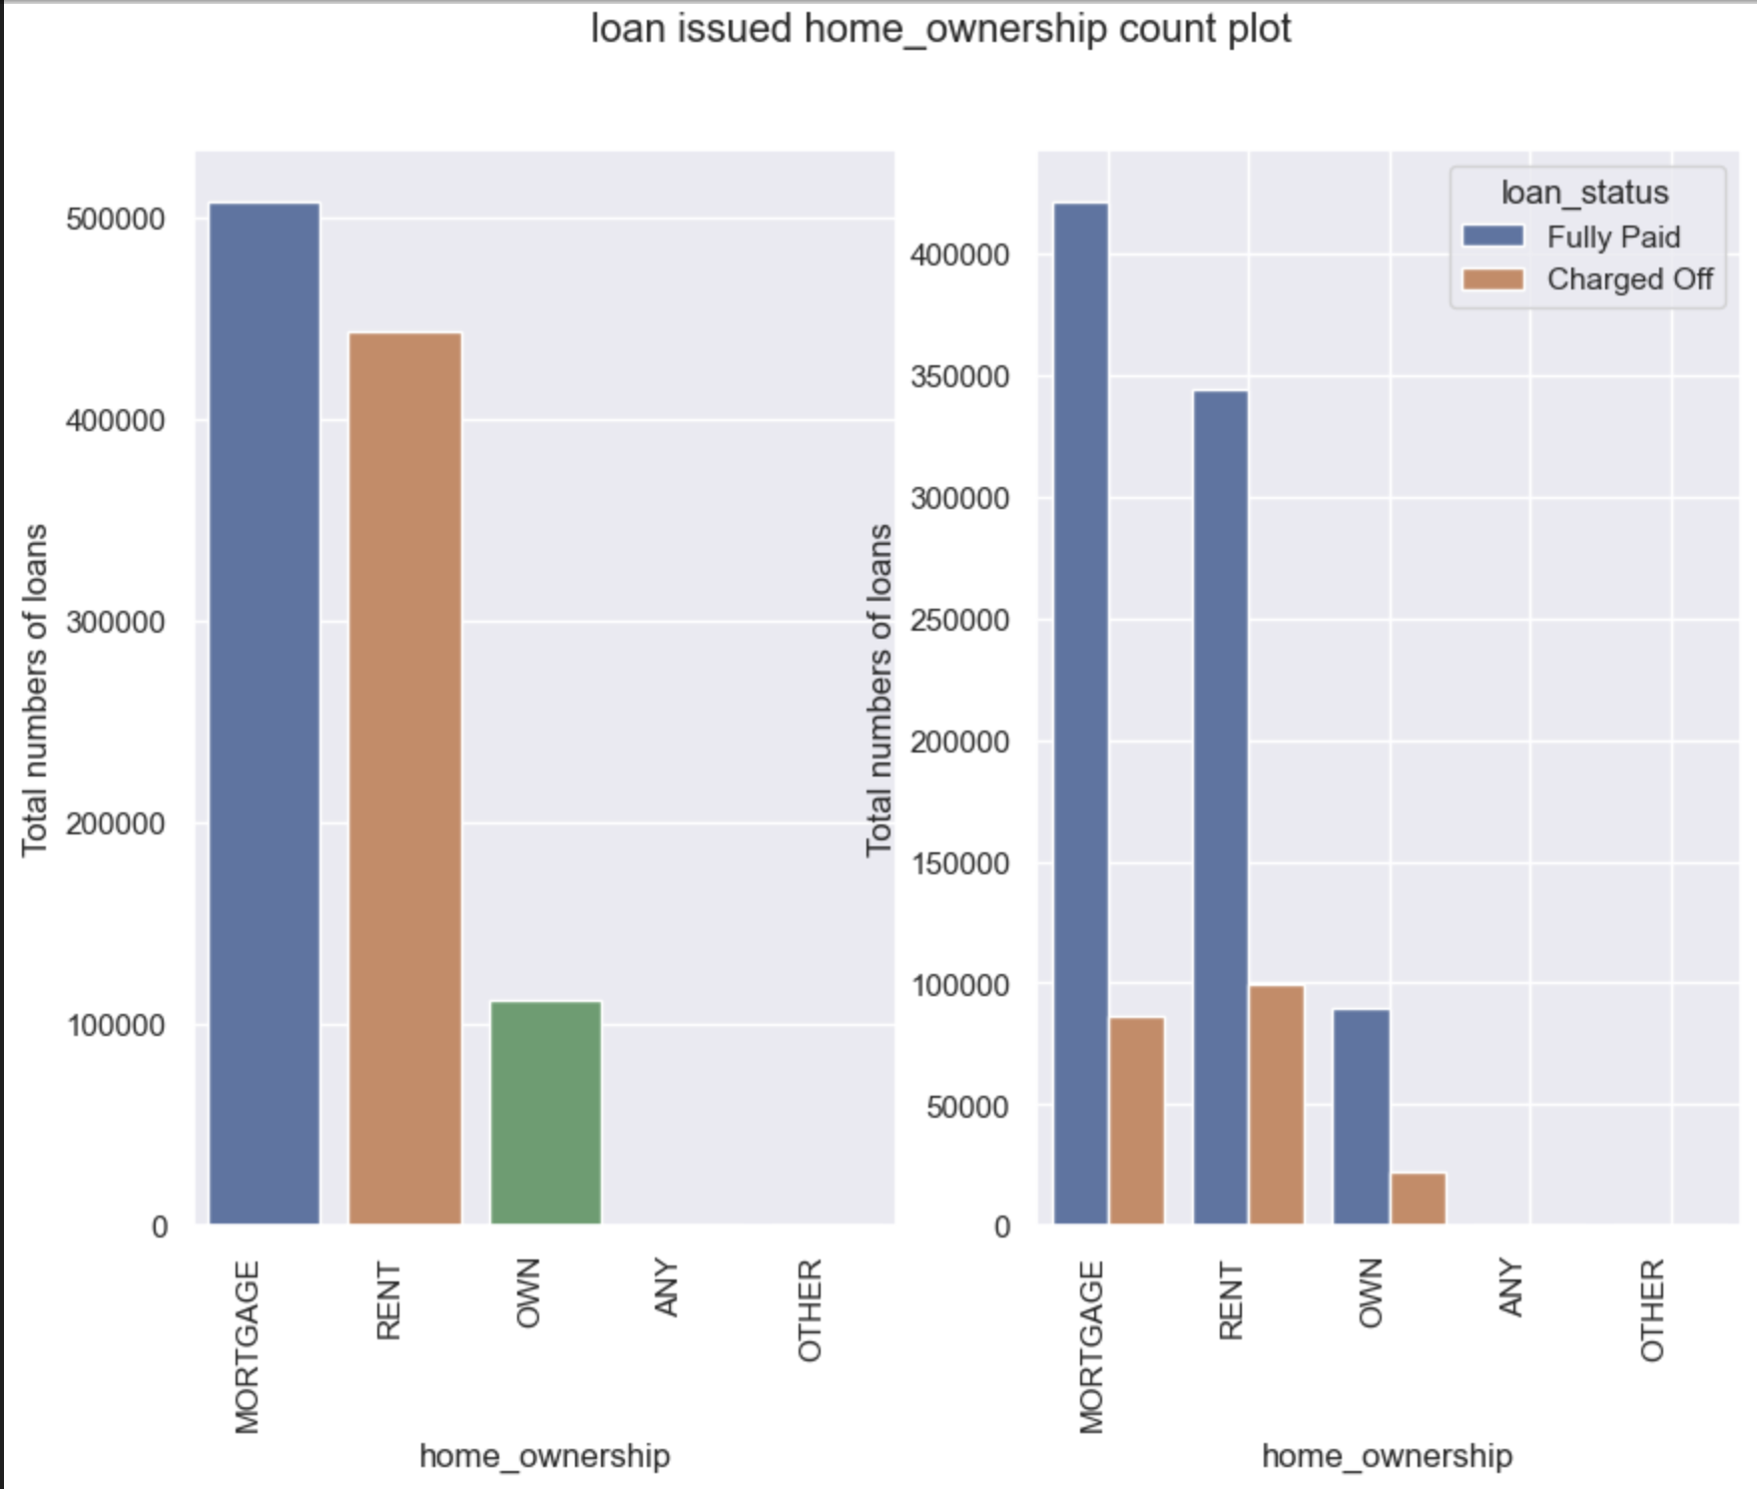
Univariate and Bivariate Analysis
Here we plot home ownership and number of loans given.
We observe that people paying mortgage are given the most loans.

Slide 8
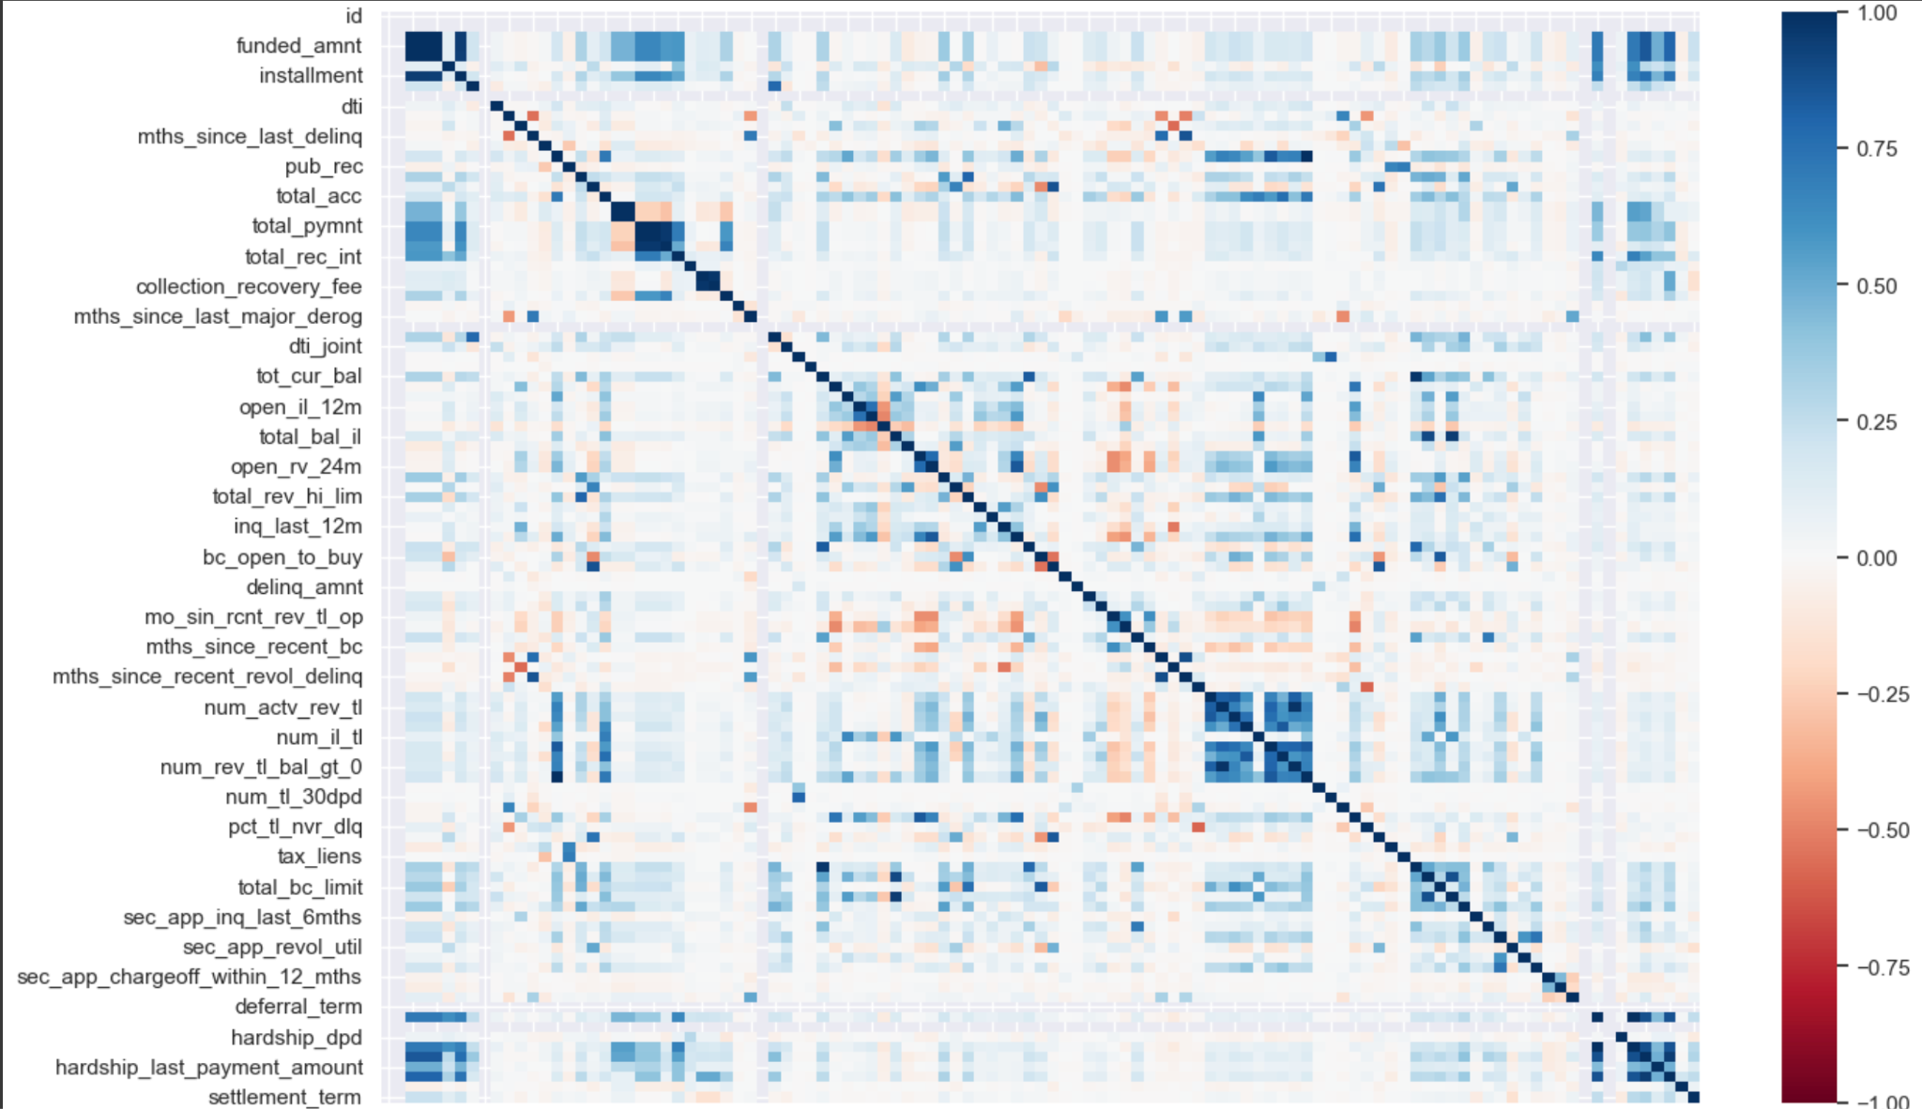
Correlation Matrix
In our analysis, we pinpointed attributes that displayed a substantial correlation with one another, exceeding a threshold of 0.7. To streamline our dataset and mitigate multicollinearity issues, we made an optimal selection, retaining only a single column from the correlated set. This step enhances the efficiency and reliability of our analysis."

Slide 9
Data Preprocessing
Data Cleaning:
Handle missing values.
Duplicates Removal.
Feature Engineering:
Create new features (e.g., debt-to-income ratio).
Encode categorical variables (e.g., loan type, payment history).
Normalize/standardize numerical variables to bring them to a common scale.
Outlier Detection:
Identify and handle extreme values that may distort the model.
Balancing Classes (Random over sampling)

Slide 10
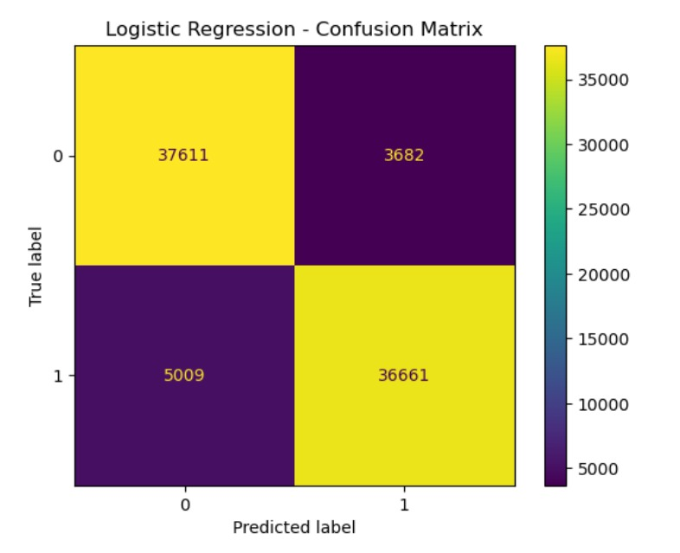
Model Performances
Recall: 0.90
Precision: 0.90
F1-Score: 0.90
So, we have a decent performance with our base model, for which we used Logistic Regression.

Slide 11
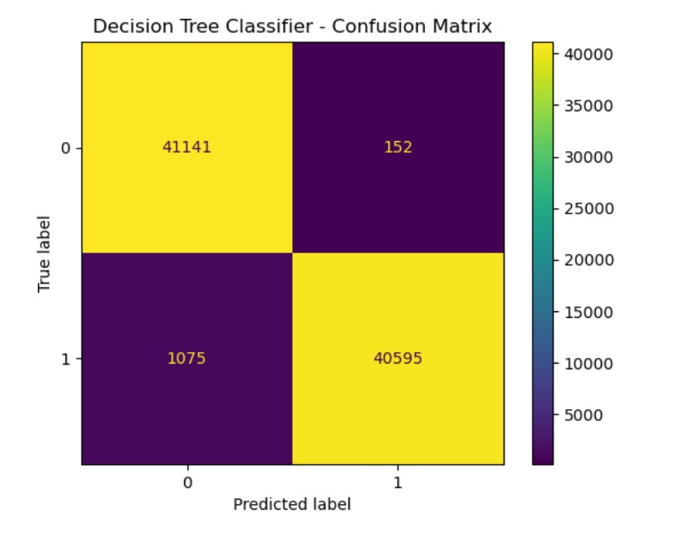
Model Performances
Recall: 0.99
Precision: 0.99
F1-Score: 0.99
So, we observe a huge improvement in the recall, precision and f1-scores compared to our base model.

Slide 12
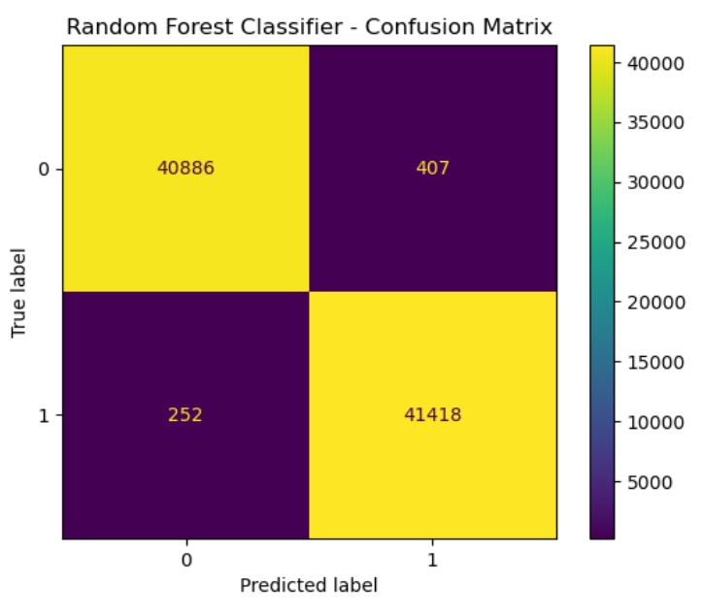
Model Performances
Recall: 0.99
Precision: 0.99
F1-Score: 0.99
We get similar performance in Random Forest Classifier compared to Decision Tree classifier.

Slide 13
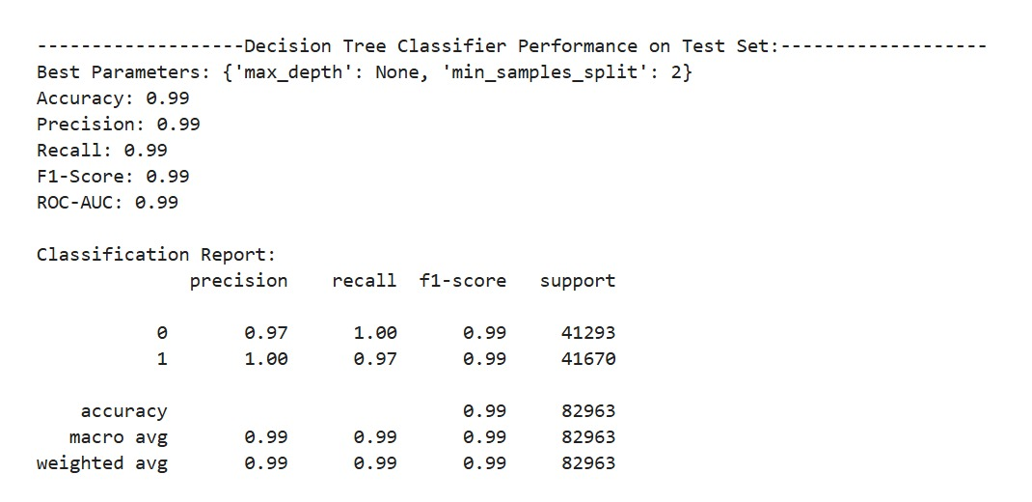
Model Performances

Slide 14
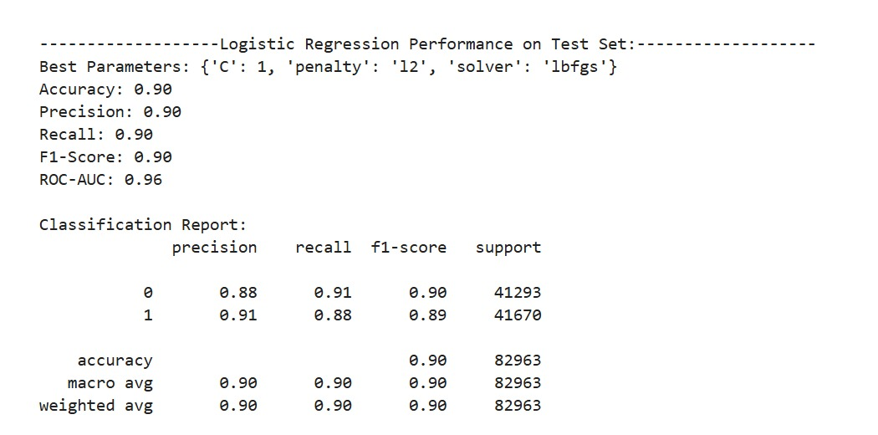
Model Performances

Slide 15
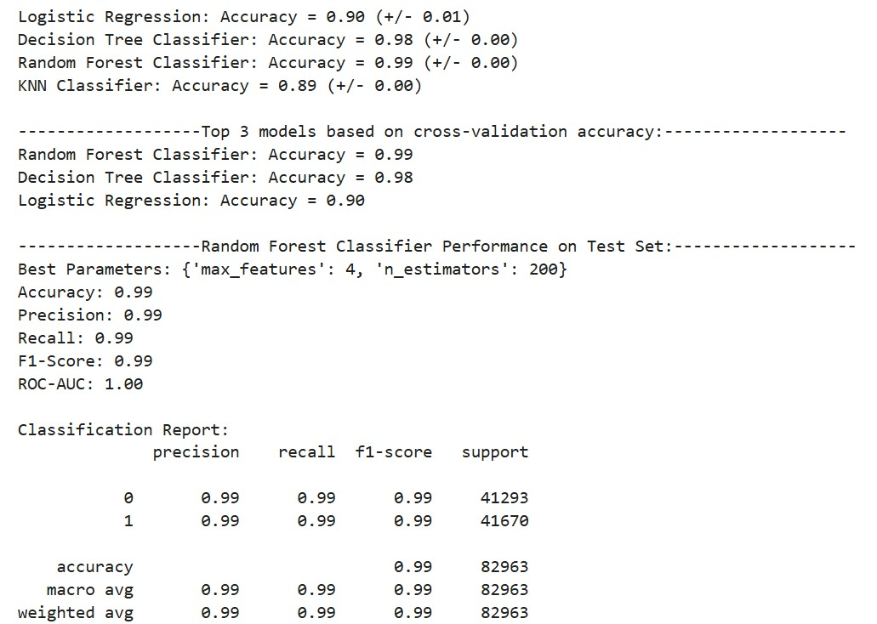
Model Performances

Slide 16
Conclusion
We effectively addressed the challenge of identifying defaulting customers through classification models. Our leading model, the Random Forest with essential features determined by GridSearchCV, delivered exceptional results with an accuracy reaching approximately 99%. This high accuracy demonstrates our model's proficiency in classifying defaulting customers, a crucial aspect of our capstone project.

Slide 17
Thank You

Slide 18
Thank you for your attention!
We welcome any questions or feedback.

